Slide 1
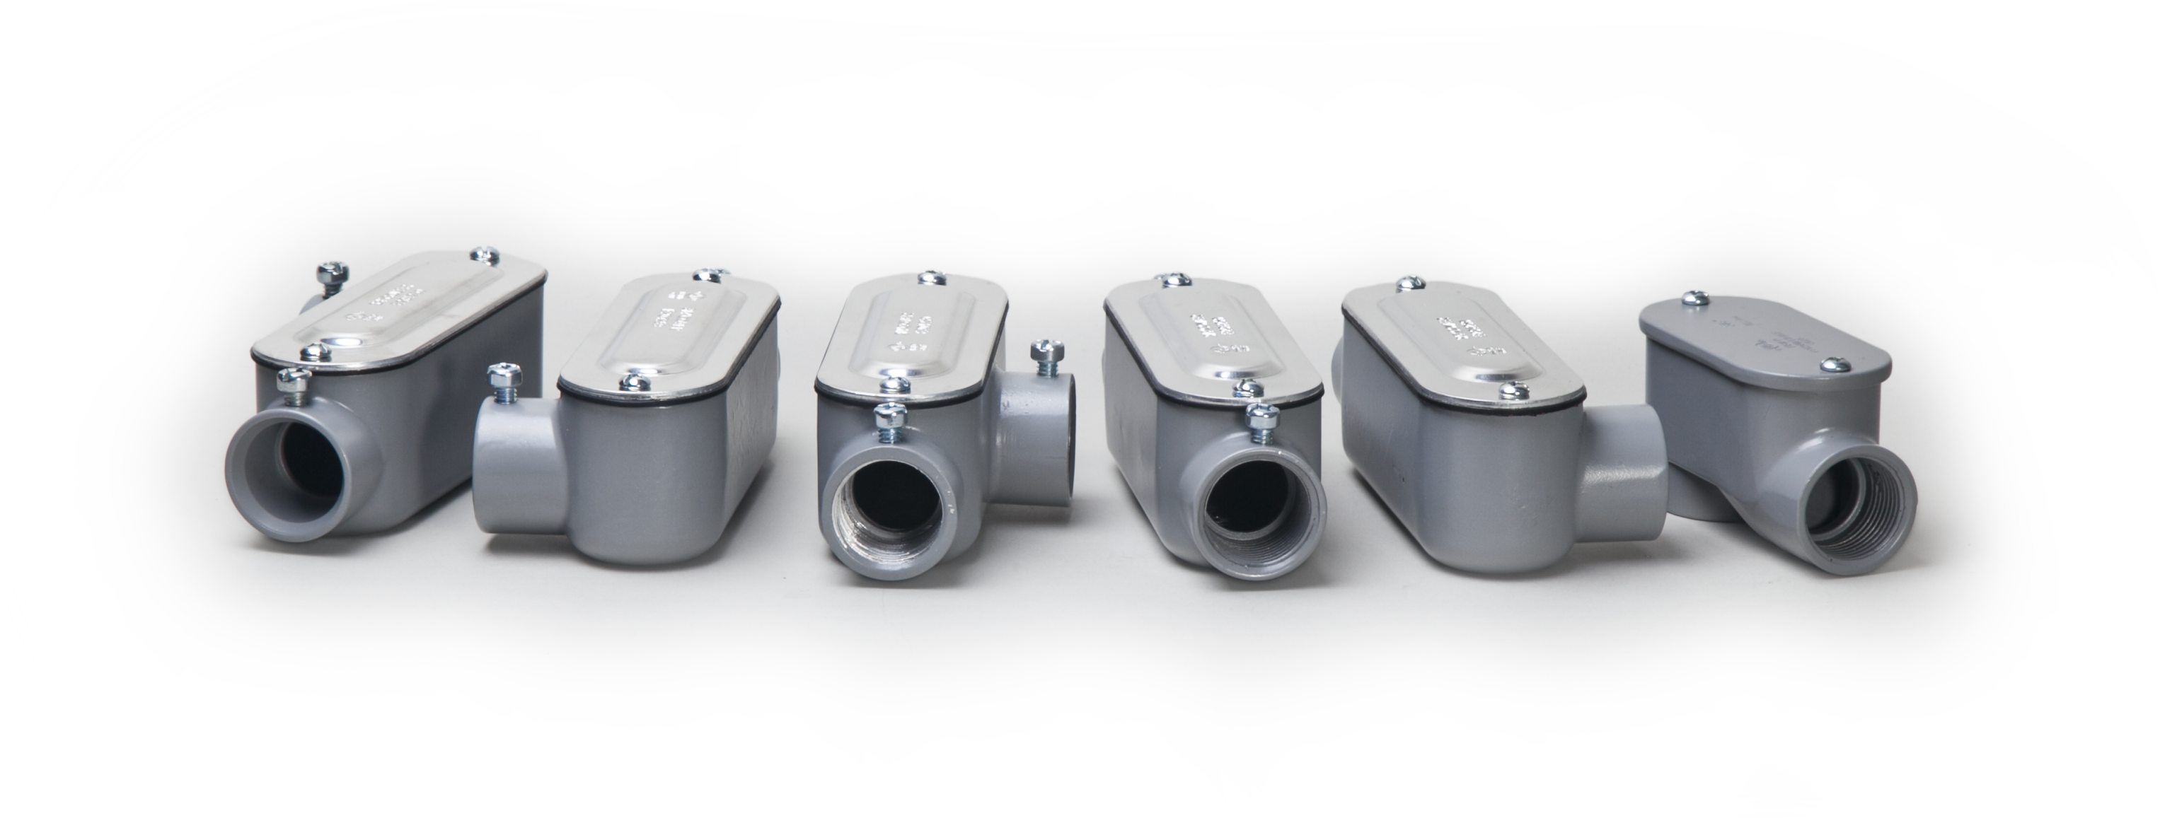
Aluminum Conduit Bodies

Slide 2
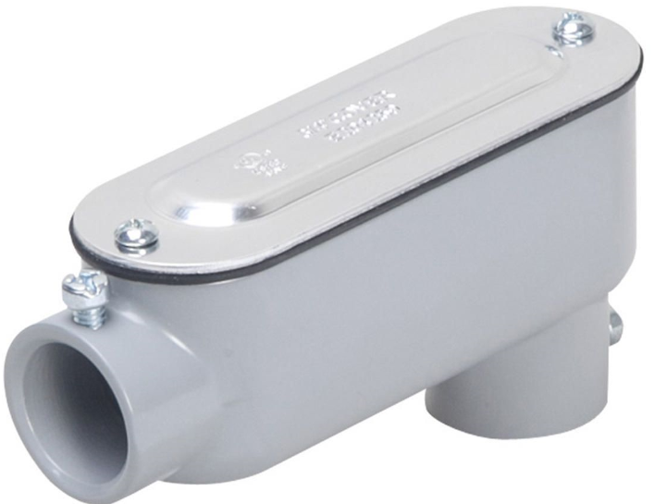
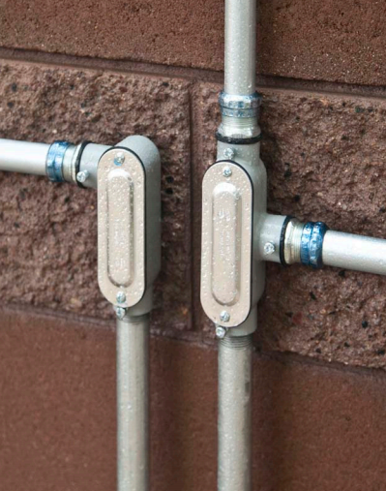
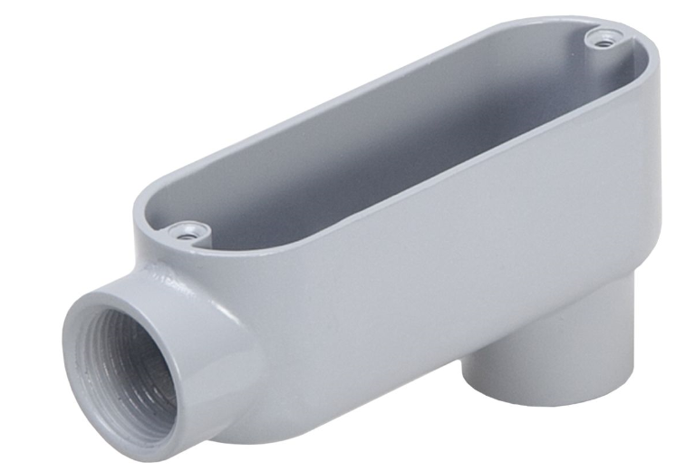
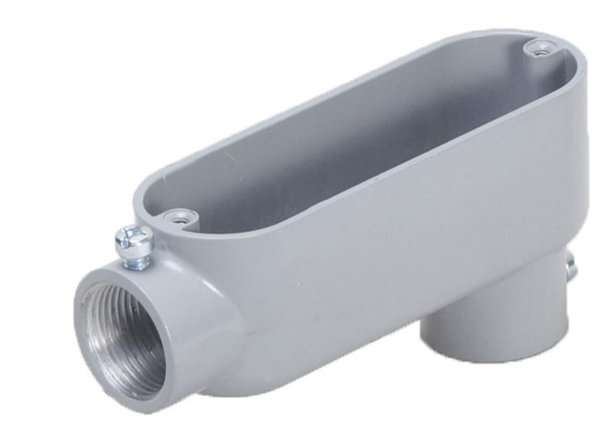
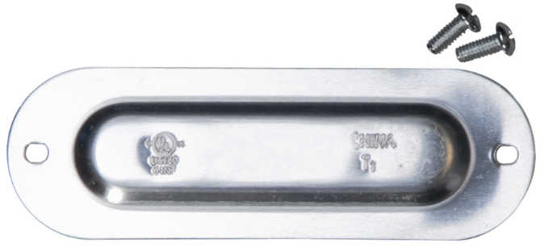
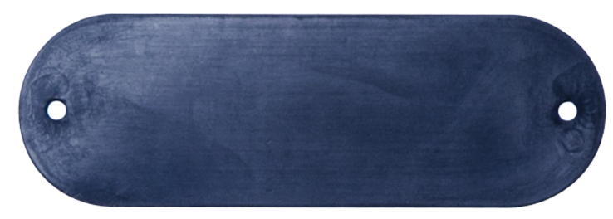
Offering
EMT, Combo, Rigid IMC
Sizes Range ½” – 4”
Offer either fully assembled or in components
Flat Back design allows for easy mounting close to walls
cULus listed
NEC compliant
NEMA 3R rated
Cubic inch capacity clearly marked
EMT
Rigid/IMC
Combo

Slide 3
Competition Comparison

Slide 4
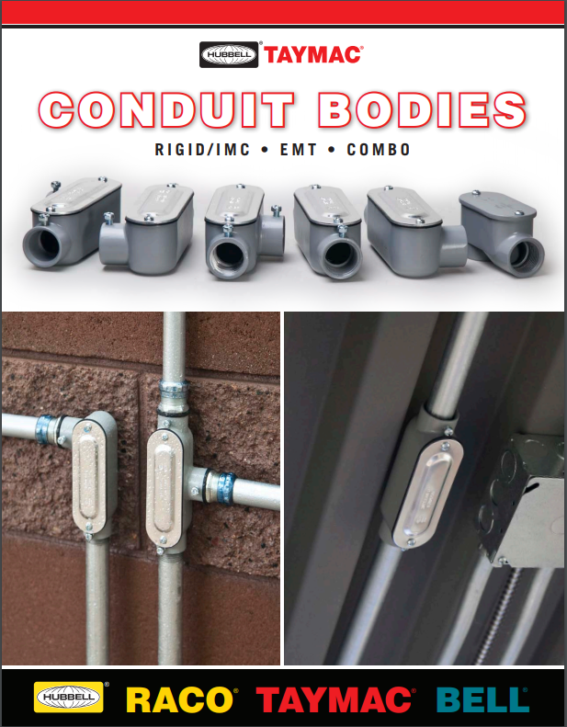
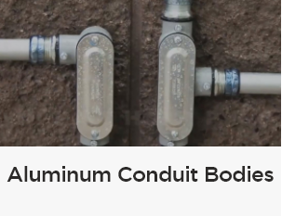
Available on Hubbell.com/taymac/en
Video
8 page Brochure
https://hubbellcdn.com/ohwassets/HCI/TayMac/Literature/TM-004.pdf
https://youtu.be/mb-hToT9vZw

Slide 5
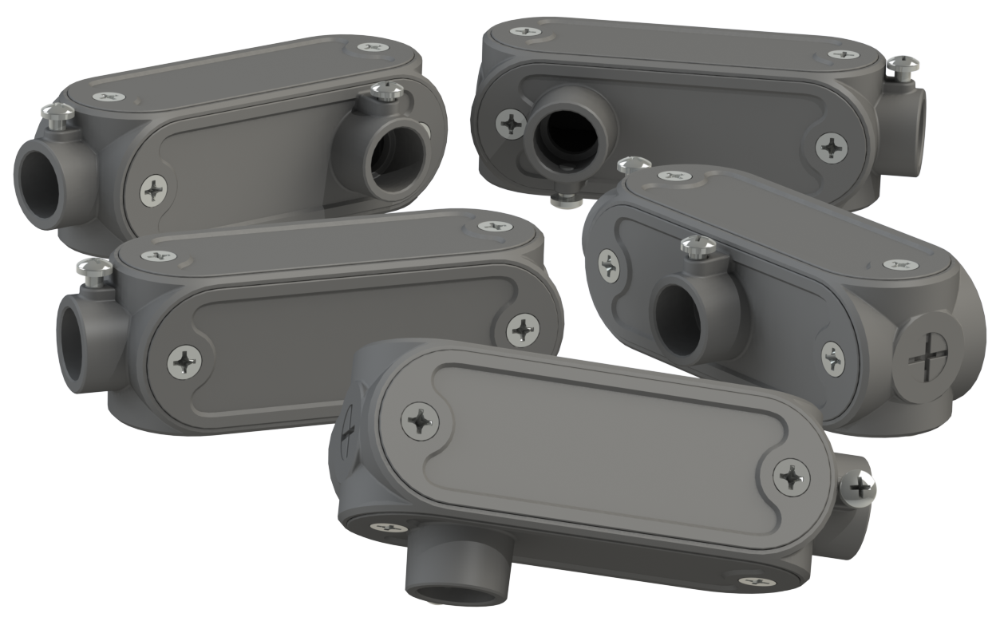
U-Conduit

Slide 6
Background
TayMac offers a full line of commercial grade aluminum conduit bodies for either Rigid/IMC or EMT, and Combination bodies that accept both conduit types
  totaling over 250 part numbers
Multiple sku’s are necessary in order to cover each conduit application type and configuration requirements
  increased sku management
  complicates space constraints on service trucks
This can create multiple trips for the service truck to get the correct product for the job
  increasing labor costs

Slide 7
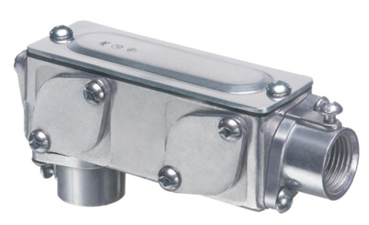
Competition
Arlington AnyBody
Limited access to LB, LL, LR, and T ports - limited access for a straight pull of wires
Hub design reduces cubic inch capacity (4.8 cu in for ½”, 7.8 cu in for
¾”, and 11.5 cu in for 1”)
Hubs and cover plates do not have captive screws
Loose/separate gasket - increases time to install and manually align with cover
Cumbersome, bulky, heavy, square design
Too many components, loose gasket, limited access
Offered in trade sizes ½” through 4”
Offered as a combo body for both Rigid/IMC & EMT up to 2” trade size
Offered in plastic for PVC pipe

Slide 8
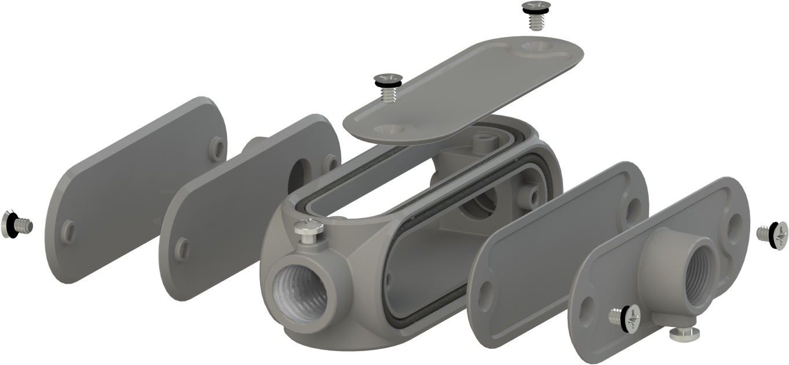
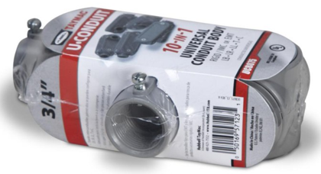
TayMac Solution
10 in 1 design: 5 configurations (LB, LL, LR, T, & C) for both Rigid/IMC and EMT conduit
Available in trade sizes ½”, ¾” and 1”
Captive cover/panel screws
Combo head set screws
Time saving & easy installation
Comes pre-configured for LB/LL install
Ideal for service trucks and reduces inventory
Reducing bushings (for 1” and ¾” trade sizes), closure plug, and all hardware included
cULus Listed

Slide 9
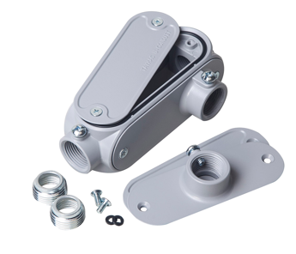
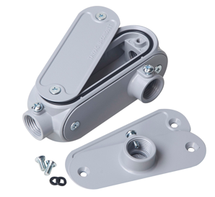
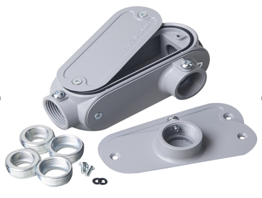
Offering
UCB050
UCB075
UCB100

Slide 10
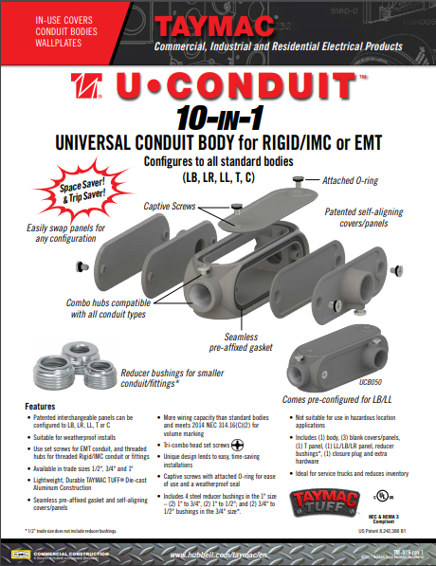
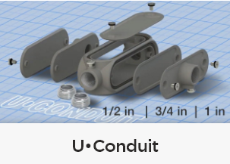
Available on Hubbell.com/taymac/en
Sell Sheet
Video
https://youtu.be/tHselwJC3Lw
https://hubbellcdn.com/ohwassets/HCI/TayMac/Literature/TM-016.pdf

Slide 11
Questions??

